Slide 1
Capstone Project - The Battle of Neighborhoods
---------Analysis of the the most Venues around Aachen, Germany

Slide 2
Introduction
In week 3, we explored New York City and the city of Toronto and segmented and clustered their neighborhoods. Both cities are very diverse and are the financial capitals of their respective countries. One interesting idea would be to compare the neighborhoods of the two cities and determine how similar or dissimilar they are. But how will be this situation in a small city? Just like Aachen in Germany.
So if I want to look to open a restaurant in aachen, where should I open it? Similarly, if a contractor is trying to start their own business, where would you recommend that they setup their office?

Slide 3
Data
In order to accomplish this goal, latitudes and longitudes of the Aachen are required. We can find the PLZ in Aachen and also where is assigned for these PLZs. We can use getcoder.arcgis(‘Aachen Germany’) to get the location information of Aachen. From this data, I need to select the relevant shops and positions around the aachen and using their latitude and longitude values, I need to explore the venues with "art" section around Aachen by utilizing Foursquare API.
The data contains regions, corresponding latitude, longitude and country name along with many other features. I only use the features that I mentioned in this data and then filtered the regions.
Then I used the acquired location data to explore the nearby art venues from the Foursquare API. Using the "explore" option, I look for top 10 art venues in 30 km radius for each city center and I get "Venue", "Venue Latitude", "Venue Longitude" and "Venue Category".

Slide 4
METHODOLOGY
Then we use the one hot encode and transform the data as we want. Finally we can get the relationship between the regions and the venues. Through the calculating the clusters, we set the clusters as 8, and then use the k-means algorithm and do the classification.

Slide 5
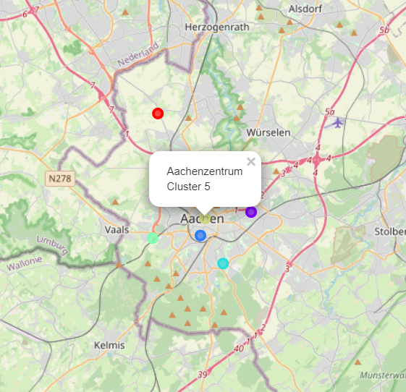
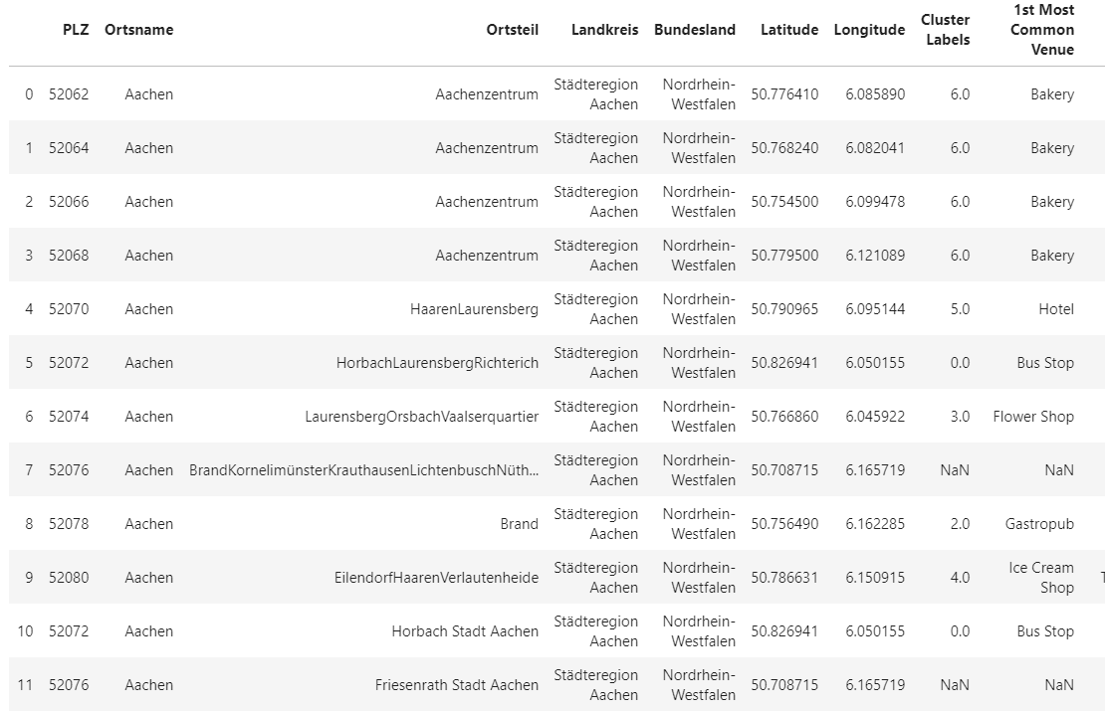
Results
Bakery is very popular

Slide 6
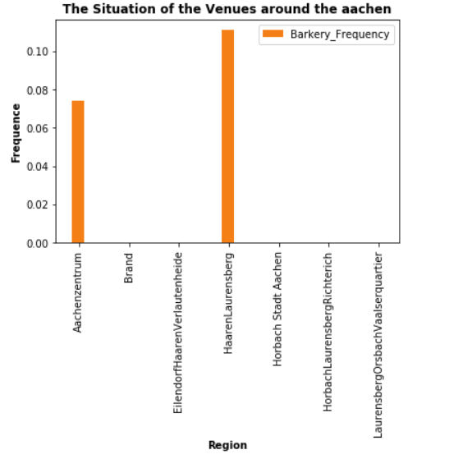
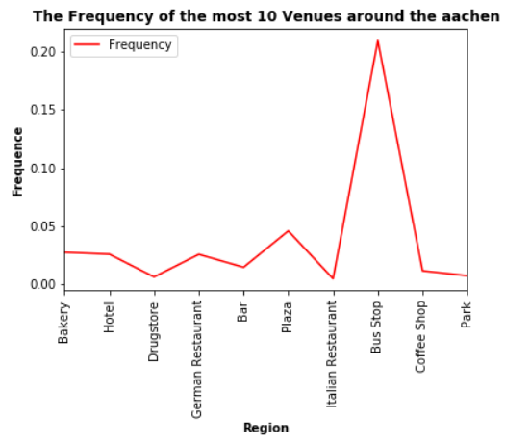
Results
Central aachen and west-north aachen is suitbale
For Barkery
Calculate the mean of the frequency and ploz

Slide 7
Conclusion
The most popular restaurant is pizza shop
And the 1st Most Common Venue is bakery in some regions.

Slide 8
Thank you for your attentions!

